Slide 1
ASOBU KA SHINU
ABOUT US:
1.Shehabul islam Sawraz-1805088
2.Abrar nafee akhand-1805089
3.Mobaswirul islam-1805090
SUPERVISOR:MD.SAIFUL ISLAM SIR

Slide 2

Story of the game:
Mario and Naruto lived in Hidden leaf village.They set out a journey for finding hidden treasures in the Sandcraft village.For this,they had to pass some steps that were too hard.They had to cross many obstacles like bombs,minecrafts etc.There were three steps to reach to the treasure.The first and second steps were easy to Mario than Naruto.But the third step was easy to Naruto.That’s why they chose and passed the steps according to their ability.

Slide 3

Getting player name:
Input Your Name here

Slide 4

Functions of main menu:
Start
Quit Game
How To Play
Sound ON/OFF
Credits

Slide 5

Functions of pause menu:
Continue
Restart
Click it to return to main menu

Slide 6
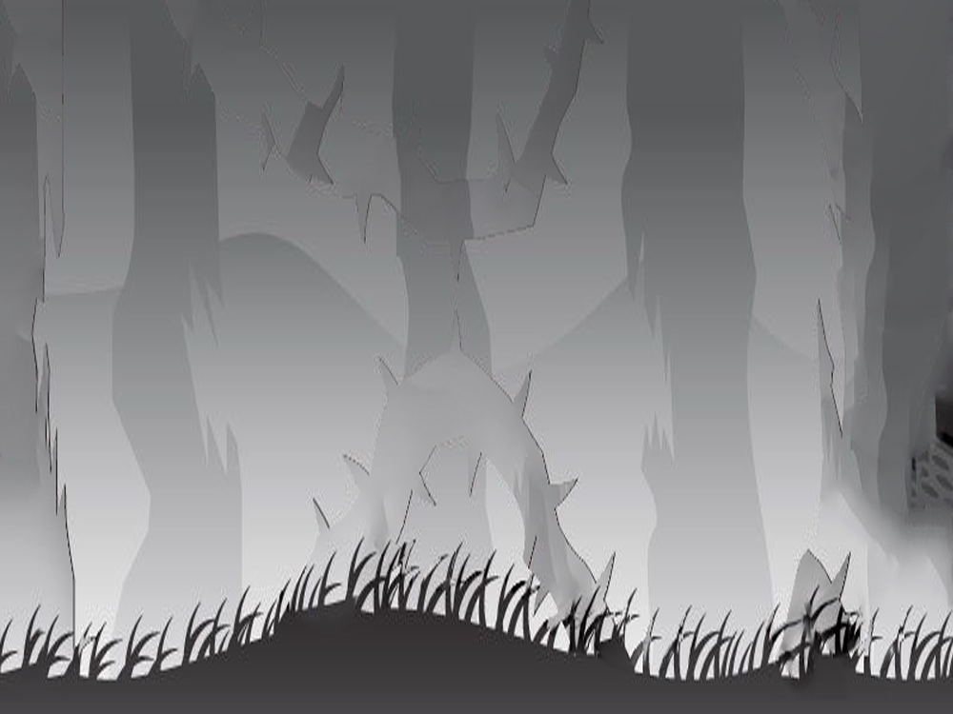
HOW TO!
Press LEFT/RIGHT arrow key or A/D to MOVE.
For Level 1 &2:
Press UP arrow key or W to JUMP.
Press UP/W twice to use TURBO!
For level 3:
Long press UP arrow key to go UP.
Long press DOWN arrow key to BEND DOWN.
Press F for PARABOLIC JUMP.
Press ESC for Pause Menu

Slide 7


Features of level 1 & 2:
There are some obstacles in these levels. You have to cross them without any collision with them. You have three lives. If you get any collision with them, the number of life of the character will decrease by one and a blast will happen. The faster you finish the level, the more points you get. Moreover, when the level will be completed ,you will get extra points depending on the number of character’s life you have saved. There is also an extra life for rescuing your character from danger.
Obstacles
Extra life
There are also some eye-catching features to make the levels easier.Magic carpet is one of them.
Magic Carpet

Slide 8
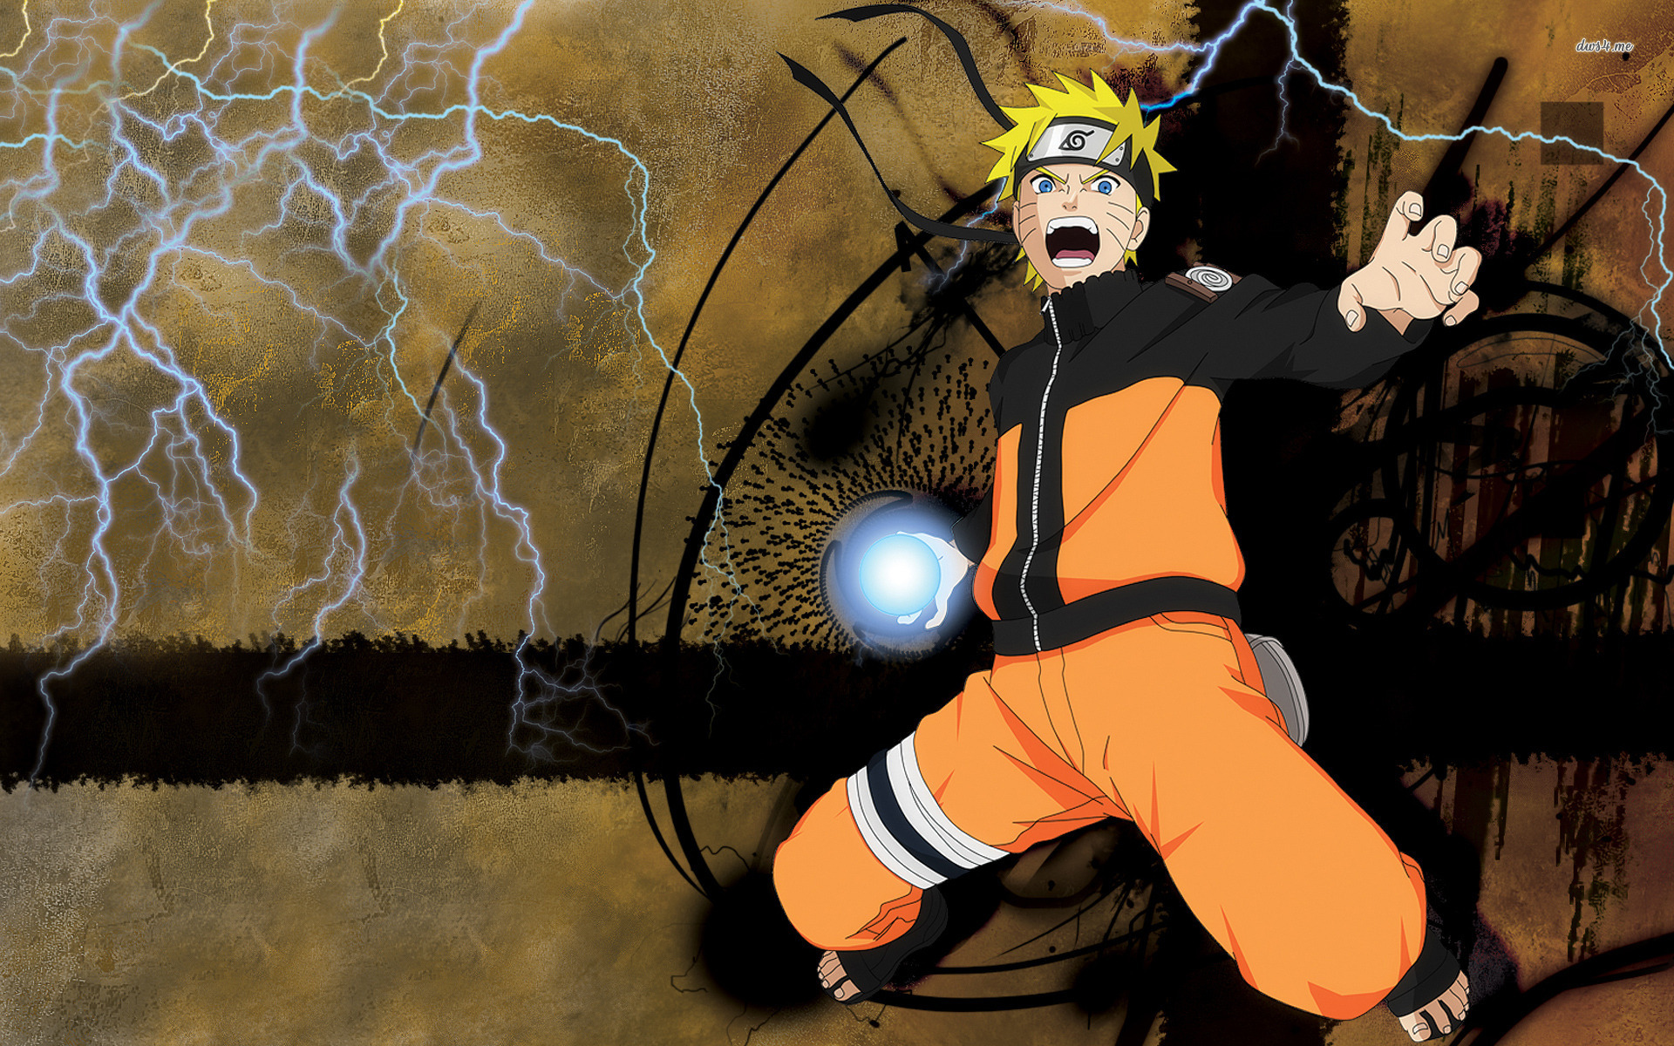





Features of level 3:
There are some obstacles in this level.You have to cross them with any collision with them.You have three lives.If you get any collision with them,the number of life of the character will decrease by one and a blast will happen.The faster you finish the level,the more points you get. Moreover, when the level will be completed ,you will get extra points depending on the number of character’s life you have saved.There is also an extra life for rescuing your character from danger. In this level you will face obstacles from up and right at the same time.Also you will face some minecrafts which is also your enemy.You just have to protect yourself from the enemies and reach the end point.As soon as you will reach the end point , you will get the treasure and your mission will be successful.Some examples of the enemies are given below:
Obstacles
For making the level easier,you also get an extra life and checkpoint.

Slide 9

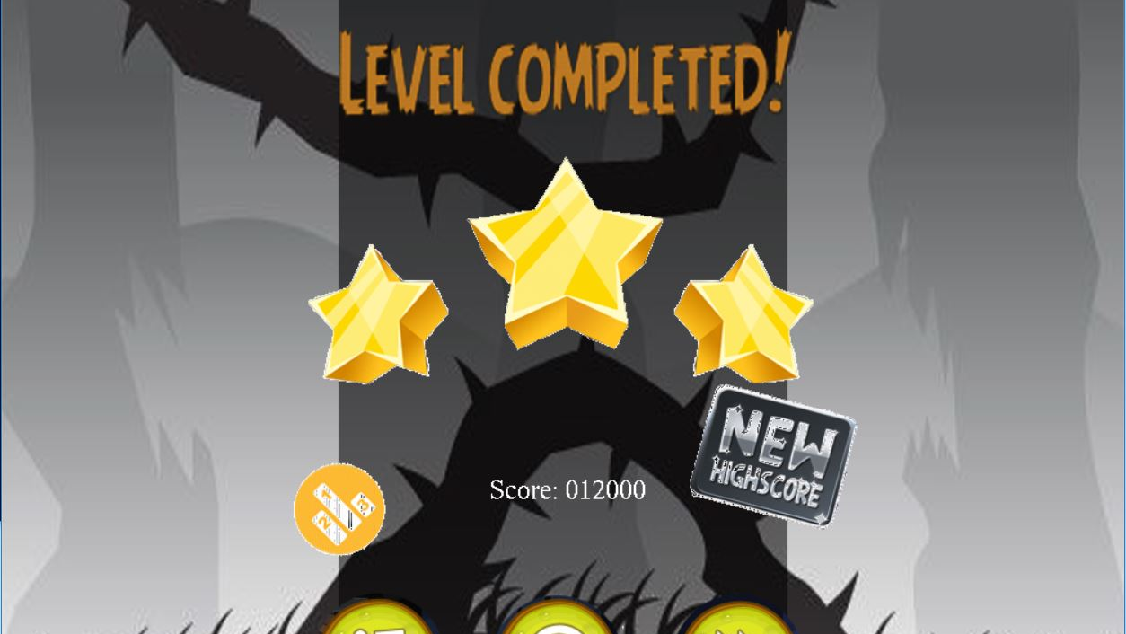
If you can overcome the obstacles of the level, you will be scored according to your remaining life, time elapsed and level hardness.
You can then go to the next level or play the level again for a better score.
You can also check your position in the leaderboard.

Slide 10
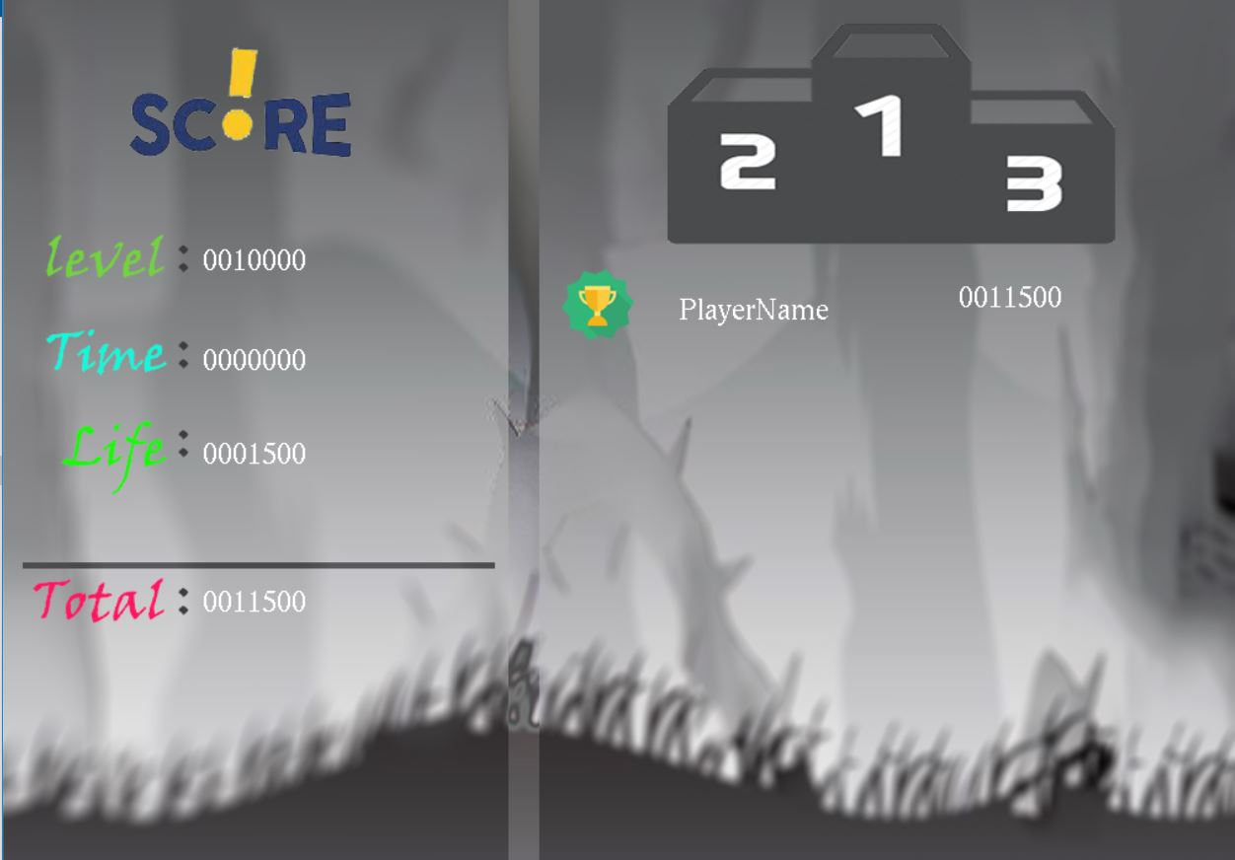
In the leader board you can see your score distribution and position. First 5 player will be shown from each level.

Slide 11
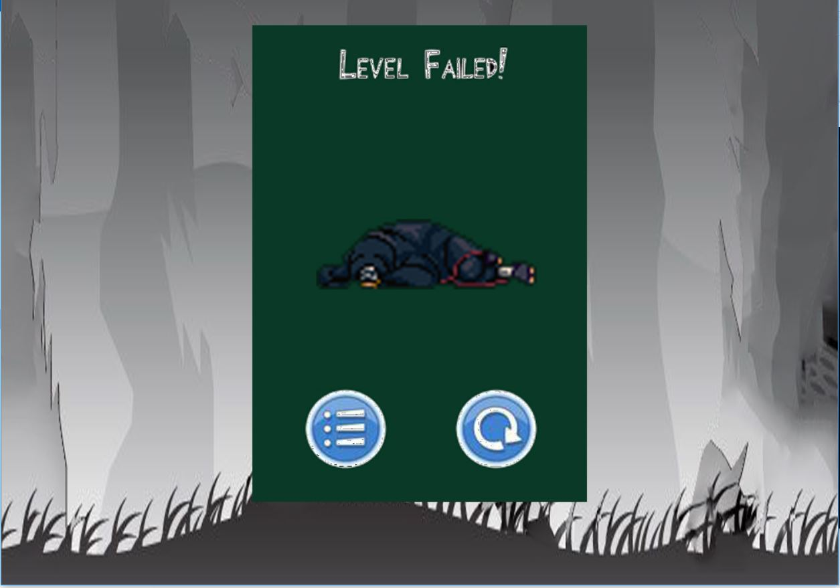
In case you fail, you can retry the level.

Slide 12
GOOD LUCK!
Persist Until Succeed!

